Slide 1


Slide 2

Cloudjacking
for Command and Control

Slide 3




Accenture Security 埃森哲安全
Vincent Yiu 姚旻言
Security Manager, Red Team 安全经理
Advanced Threat Services
_{L}
@vysecurity
Notes:
Hi there,
First of all I want to thank JD for inviting me to speak this year.
A quick introduction about myself. I am an operator and manager on the FusionX red team at Accenture security. On a day to day basis I simulate real threats against our client’s organisations. Most of the time I am probably transferring money, decrypting card data or obtaining business intelligence. I’m sure penetration testing is a term everyone is familiar with. So comparing it to penetration testing, you can think of penetration testing as hitting a punching bag, whereas red team is sparring with a live partner.
This research came about as part of my early research towards extending command and control capabilities through the cloud.

Slide 4
01
Domain Fronting 101
什么是 domain fronting?
02
Cloudjacking – CDN
介绍 Cloudjacking –
Domain Hijacking Content Delivery Network customers
域名劫持内容分发网络客户
目录
03
Contents
Cloudjacking - Storage
介绍 Cloudjacking –
Domain Hijacking Cloud Storage Provider customers
域名劫持云存储提供商客户
04
Benefits, Remediation and Discussion
What are the benefits to threat actors?
对威胁攻击者来说有什么利益？
How do we fix this issue?
我们如何修补这个漏洞？
Notes:
In this talk I will first discuss a previous technique we have been abusing for the past few years and then in the latter half of the presentation, a new technique that utilises cloud services.
Domain Fronting… basics, guide, background. This was introduced in 2016 and has been used by threat actors in 2017. Last one I saw in the wild was August 2017.
Cloudjacking, new technique, utilised more in 2018 and beyond
Benefits, remediation and discussion

Slide 5
Domain Fronting 101
近几年来被TOR研究并使用来绕过审查
2016年在攻击行为中作为武器来使用
这个技术在2017年初成为主流
利用内容分发网络中的核心设计缺陷
不只是针对于一个云或基础架构服务提供商
被威胁行为者利用
Notes:
Historically used by the TOR to bypass censorship issues. To prevent TOR a provider would then need to intercept all TLS traffic or block entire cloud IP ranges, which would almost be impossible.
Domain fronting was weaponised in 2016 and became more mainstream in 2017. Most of the blog posts around this research was in English. Some followers in Beijing have actually translated this into Chinese and discussed it on their own blogs. I would definitely recommend reading up and testing some of these techniques yourself.
In basic terms, Domain Fronting utilises a flaw in the way how content delivery networks operate. We will understand this a bit better in the next few slides.
This is not specific to one specific cloud provider. I’ve found that you can domain front through both western and south east Asian based cloud providers. It’s an inherent issue in CDN design so no one will fix it. There are some ways for cloud providers to make it more difficult to weaponise the technique…
As previously mentioned, I’ve actually last seen this technique in use around August this year.

Slide 6
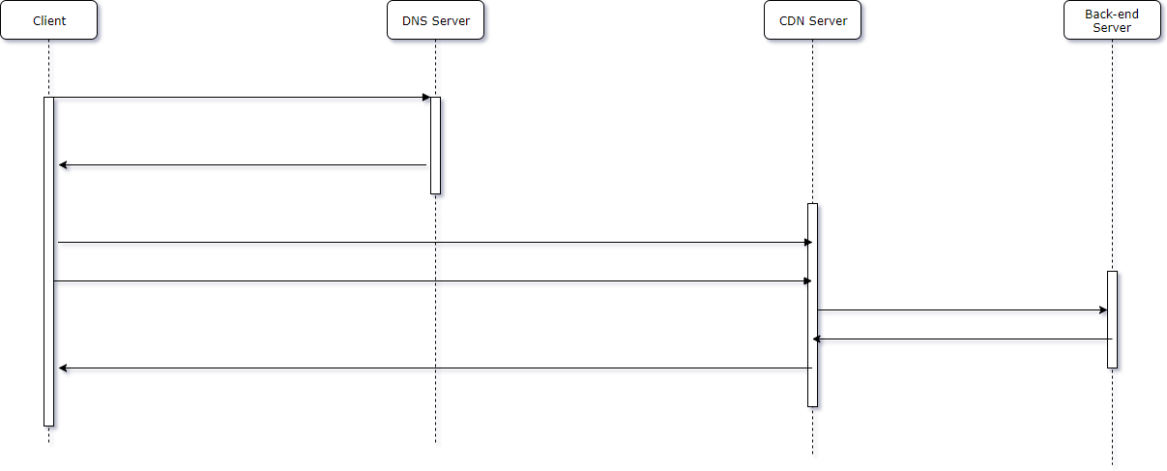
Domain Fronting
基础
访问
cdn.company.com
1）查询 cdn.company.com (查询DNS A 记录)
2）CDN 服务在IP A,B,C,D,E(响应DNS A记录请求)
3）连接IP A,B,C,D或E，请求最近的内容传送网络节点
4）从CDN 获取请求Host：cdn.company.com的资源(比如:GET /index.php;Host:cdn.company.com)
5）获取cdn.company.com的 /index..php
6）/index.php
7）响应通过 CDN 获取的 /index.php
Notes:
Content Delivery Networks work roughly as shown in this diagram.
I’m not a CDN expert and I have not implemented a CDN, but this is how I see it from an attacker’s perspective.
Here we have 4 objects, the client (your computer), the DNS server, the CDN server (whatever cloud provider), and a back-end server that belongs to the cloud provider.
Let’s work through the typical process for fetching content from a web server that uses a content delivery network. In this scenario we are going to fetch index.php from cdn.company.com
What happens is, your computer will perform a DNS lookup for cdn.company.com and it will actually obtain a CNAME and fetch multiple IP addresses for the cloud provider’s CDN nodes. Typically there will be a few, such as in this case, IP A, B, C, D and E. These are typically dependent on the region and location you are at, and the DNS will provide the closest CDN IP addresses to your computer.
Your computer will then connect to the closest CDN IP and send it a HTTP GET request for the resource. In this scenario, we will get /index.php. The web browser will automatically insert the domain name you had requested into the Host header of the HTTP packet.
When the CDN server receives this packet, it will parse the Host header to determine what website you attempted to retrieve then send the request to a back-end server. It will fetched cached content if possible to speed up the delivery.
It gets the content, then sends it back to the computer.
We can see that there’s actually a core flaw around the content that the CDN server gets, we will see how this works in the next slide.

Slide 7
Domain Fronting
基础
通过cdn.company.com获c2.hacker.com/a.png
1）查询 cdn.company.com(查询DNS A 记录)
2）CDN 服务在IP A,B,C,D,E(响应DNS A记录请求)
3）连接IP A,B,C,D或E，请求最近的内容传送网络节点
4）从CDN 获取请求Host: c2 .hacker.com 的资源(比如:GET /a.png; Host:c2.hacker.com)
5）获取c2.hacker.com的 /a.png
6）/a.png
7）响应通过CDN获取的 /a.png
Notes:
When we abuse this issue, we are creating the domain fronting technique.
Instead, what we want to do is still perform the cdn.company.com resolution, so that the DNS server sends back a list of closest edge nodes. This is typically what a web proxy would also perform if you were looking up the host.
Once the IP address comes back, we send a new packet to the CDN server and issue a GET /a.png; I am using a.png because it camouflages well. The host header is set to c2.hacker.com Which I operate.
When the CDN server obtains the packet, it will take the host header, then fetch the content from my website. Then serve it back to the computer. So as far as the computer is concerned, or the web proxy in the middle, I am downloading content from cdn.company.com.

Slide 8

可以使用什么
Domains?
Discovering front-able domains
01
https://github.com/vysec/DomainFrontingLists
找到云服务提供商
02
找到两个使用同一个云服务的网站
03
使用指定的 Host:website-b.com
链接 http://website-a.com
04
如果请求到website-b的资源，
那么就可以domain fronting。
Notes:
Now you might be thinking. What companies are vulnerable? How do I get a list of these vulnerable domains? How do I know what cloud providers are vulnerable?
Obtain two websites that use the same provider
Take the first website, resolve the IP, send a Host: website-b.com to http://website-a.com. You can do this in wget command or use a browser plugin.
If you get the content of website-b when sending a packet to website-a. Then you know you can domain front through this provider.
I’ve actually taken a list of major providers across the world and found a large list of frontable domains and it exists on my GitHub repository as shown above. You can check out some of these lists yourself.

Slide 9
Domain Fronting in Command and Control
使用Domain Fronting作为C2的演示视频
演示给我们看！
Notes:
Show Domain Fronting Command and Control Video
Show wireshark
We are using HTTP here so that I can show you the traffic.

Slide 10
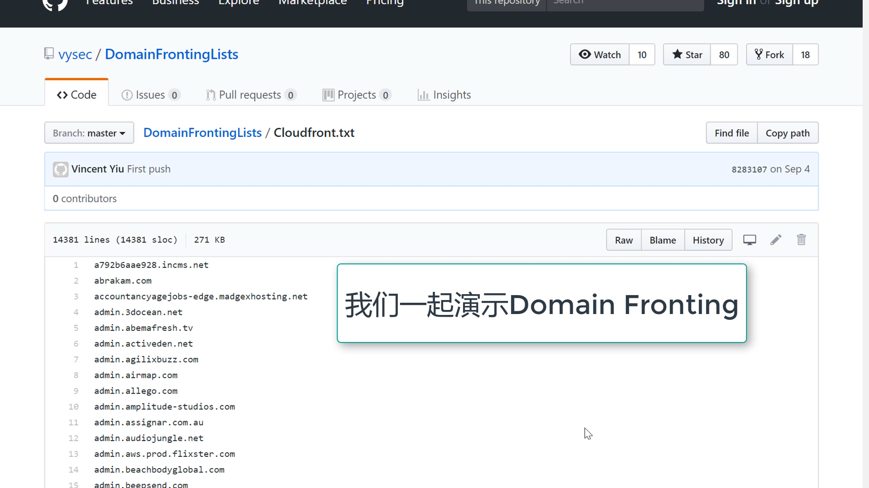

Slide 11
Cloud Domain Hijacking!
2018年的下一代技术！
Domain Hijacking
不是一个新概念
利用DNS的核心设计
使用当前域名的声望
Notes:
Now, let me introduce you to Cloud Domain Hijacking, a new technique I’ve been working on for 2018.
This will most likely be abused by threat actors coming forwards as it is easily discoverable and exploited.
Domain Hijacking isn’t a new technique, it’s been around for a long time. Cloud domain hijacking has been used somewhat by bug bounty hunters but not made mainstream.
Uses exactly how DNS is designed to operate.
Compromises and uses the reputation of existing domains. So for example, if the website you are targeting is categorised as banking and financial, a web proxy may allow this traffic through.

Slide 12
传统的 Domain Hijacking
在过去的20年里，它是如何被利用的？
CNAME
RECORDS
ABANDONED
DOMAINS
REGISTER
“
“
“
01
02
03
static.company.com CNAME static.companystorage.global
static.companystorage.global 已经被遗弃了
攻击者注册了static.companystorage.global，所以可以控制 static.company.com 的内容
Notes:
Before we go into cloud domain hijacking, let’s quickly go over traditional domain hijacking.
1) Historically, domain hijacking is performed by finding domains that have a CNAME record set to a secondary domain. Such as static.company.com pointing CNAME to static.companystorage.global
2) Now, if static.companystorage.global no longer exists… it can be described as abandoned. This can occur when a company does not keep track of its assets over a long period of time. Or perhaps the company has gone through mergers and acquisitions type of events then they perhaps no longer want the old static.companystorage.global domain.
3) As static.companystorage.global is no longer registered, we can buy this domain, set an A record, host some content and serve content on static.company.com.

Slide 13
基于云的Domain Hijacking
现在和将来！
DOMAIN HIJACKING
USING THE CLOUD!
CONTENT DELIVERY
NETWORKS
CLOUD
STORAGE
“
“
“
01
02
03
主要的云服务提供商！
重新创建废弃的内容交付网络实例！
重新创建废弃的云存储实例！
Notes:
Domain hijacking using the cloud.
Domain hijacking applies to major cloud service providers both in the west and in asia. It’s not specific to one cloud provider.
So far in my research I have found ways to hijack through content delivery network services
And also cloud storage services

Slide 14
云A – 内容分发网络 (CDN) Domain Hijacking
澄清
劫持以前使用过云A的CDN服务的域名
劫持废弃的域名
这不是domain fronting
Notes:
So how does it work?
We hijack the domain name of customers that had previously used Cloud “A”’s service. I’ve had to censor some of the brand names.
We are hijacking abandoned domains, this is not magic.
Just to clarify once more. This is not domain fronting

Slide 15
01
02
03
04
DNS
找目标
研究
利用/攻击
获取大量个DNS CNAME记录
针对特定云提供商筛选出域名列表
通过运行Hijack.py来发现那些可能被劫持的域名
验证或攻击这些可能被劫持的域名
Notes:
I will now run through the process of finding domain names that are hijackable through using the cloud.
The first step is to find or obtain a large amount of DNS data.
You then take this data and find a target service provider you want to utilise and reduce this list to a smaller set.
In step 3, I have written a script called hijack.py that basically enumerates and tells me whether I can hijack a particular domain
And finally in step 4 we want to verify and exploit the domain that we suspect may be hijackable.

Slide 16
什么是 Hijack.py ?
第3步到底是什么？
01
02
Hijack.py
连接到指定的目标域，并检查是否可以劫持一些已知的可劫持云服务
云A的CDN: “Bad Request, the Request could not be satisfied”
Storage: “The specified bucket does not exist”
Storage: “The specified key does not exist”
03
04
云A的
云B的
Notes:
At this point, you may be wondering… “What’s Hijack.py”?
So Hijack.py is a simple script that I wrote that will connect to the domain and try to discover whether it is vulnerable in some way. For example in Cloud A’s CDN instances, if it is hijackable we will see “Bad request, the request could not be satisfied”. To most people, this just looks like a website error.
Cloud A’s storage, we will see that the specified bucket does not exist. You can probably guess at this point who cloud A is.
Cloud B’s storage, the specified key does not exist.
Through fingerprinting all of these error messages on hundreds of thousands of domains and subdomains, we can find hijackable resources.

Slide 17
云A – CDN Domain Hijacking方法
劫持云A客户群的域名
演示给我们看！
Notes:
Now let me show you how you can hijack a domain in cloud A.
At this point you can use this for your command and control infrastructure or even other attacks.

Slide 18
Benefits of Domain Fronting, CDN Domain Hijacking and Cloud Storage Domain Hijacking
为什么这些技术会被采用？
1
2
3
4
5
Bypass Categorisation
Core Design Flaw
Masquerade
Difficult Attribution
Easy Deployment
网络代理可以配置为只允许流量到某些允许的网站 – 这个技术可以绕过它
为了绕过检测通常会伪装成一个合法的网站 – WHOIS指向银行，政府或者其它行业
在使用内容分发网络的主机中找到潜在的恶意主机需要云提供商帮助
利用这项技术需要相对较少的时间
这就是利用了内容分发网络的一个核心设计缺陷来改进传统C2的方法
Notes:
Now you might be wondering what the benefits of domain fronting, Cloudjacking are?
To an attacker:
We can bypass categorisation issues on web proxies. If an organisation only allows access to government websites or update websites but nothing else, then we can get our traffic through.
We can masquerade as that website, when someone does a WHOIS on that website, they may only find the real registrant of the website domain. Moreover, for some hijacked domains, the website already belongs to a fully functional business and it looks like a real website.
Difficult to attribute, unless the cloud provider sells you out or is legally forced to disclose your details. Even then, if you create a cloud provider account under fake identity, they cannot find you.
It’s easy to deploy. Both techniques are easy to use. Cloud domain hijacking can also be turned off at will. You can revert the domain back to a vulnerable state by simply disabling the instance and deleting it.
These utilise core design flaws, it makes it more difficult for defenders to find ways to discover it.

Slide 19
云A – 存储 Domain Hijacking方法
劫持使用云A的域名
演示给我们看！
Notes:
Finally, I’ll demonstrate how storage hijacking works! We can easily use this to store payloads, and phishing websites on legitimate business domains.

Slide 20
24小时 – 研究的结果！
云A存储Domain Hijacking
云A内容分发网络Domain Hijacking
5944
4083
148
云B存储Domain Hijacking
Notes:
Alright. Time for some results!
So as part of a 24 hour effort, I have found roughly 6000 hijackable Cloud A storage instances, 4000 Cloud A CDN instances and 150 cloud B instances.
The small number of discovered cloud B instances may be due to my lack of DNS data for the Asia region.

Slide 21
整治
如何修补？
禁用废弃的云实例
删除该实例的CNAME记录
不要删除实例！
Notes:
How do we fix this? What’s the remediation action? This is some remediation advice for customers of the cloud.
Disable any abandoned cloud instances. If you have used a cloud instance previously, disable it if you don’t want to use it.
However if you do stop using it, remember to remove the CNAME records pointing to it.
However, Do NOT delete the instances. Once you delete the instance, it allows an attacker to register that instance.
It’s a difficult problem to fix. Company B might be vulnerable and they can use this domain to attack Company A. Let’s say a government domain is vulnerable, an attacker can use the government domain to attack you. You cannot really stop that. I would recommend security operations centres to keep this technique in mind. If the attack does occur, you can at least see it and know that it is happening.

Slide 22


提问环节
Accenture Security
R
FusionX – Washington DC
Me? – U.K.
)
Vincent.Yiu@fusionx.com
Vincent.Yiu@accenture.com
_{L}
E
https://medium.com/@vysec.private
@vysecurity

Slide 23
THANK YOU!

